Slide 1
Mesopotamia Vocabulary
“Land between 2 rivers”

Slide 2
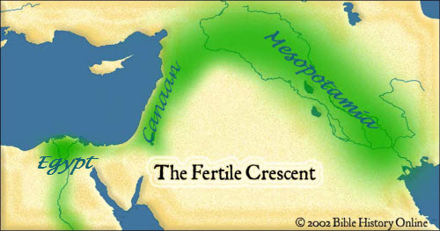
Mesopotamia

Slide 3
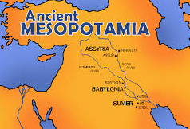
Mesopotamia
Fertile land between the rivers
(Tigris & Euphrates)

Slide 4
Fertile Crescent
ANOTHER NAME for Mesopotamia – The rich land between the Tigris and Euphrates Rivers, also includes the Nile River
- Fertile land made it good for growing crops.

Slide 5
FERTILE CRESCENT
Name for the fertile Land surrounding the Tigris, Euphrates and Nile Rivers
Fertile land made it good for growing crops

Slide 6
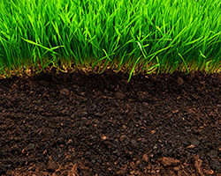
Fertile
Soil rich in nutrients and resources
Soil became rich in nutrients from rivers flooding

Slide 7
SILT
Small particles of rich, FERTILE SOIL.

Slide 8
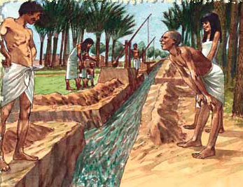
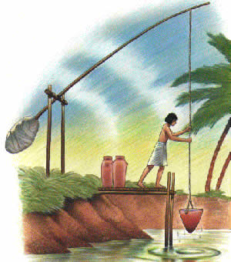
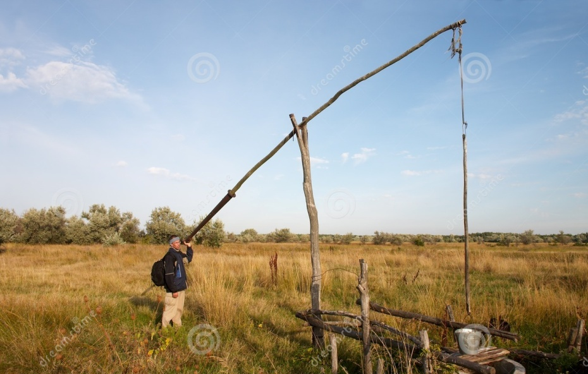
Irrigation
to bring water to DRY LAND (for CROPS)
Shadoof
TOOL used to irrigate dry land

Slide 9
IRRIGATION SYSTEM
Series of canals that brought water from rivers to crops

Slide 10
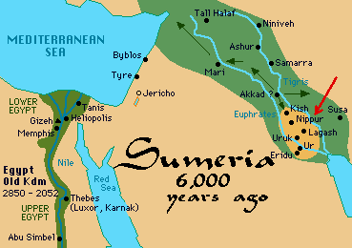
Sumerians
The first inhabitants of Mesopotamia
City state was named SUMER

Slide 11
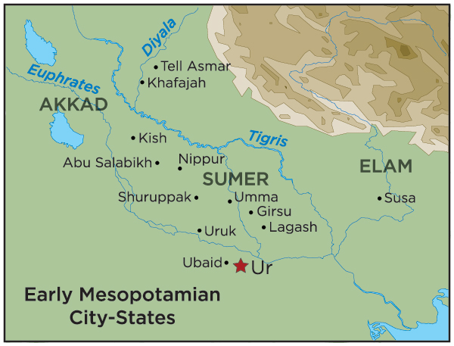
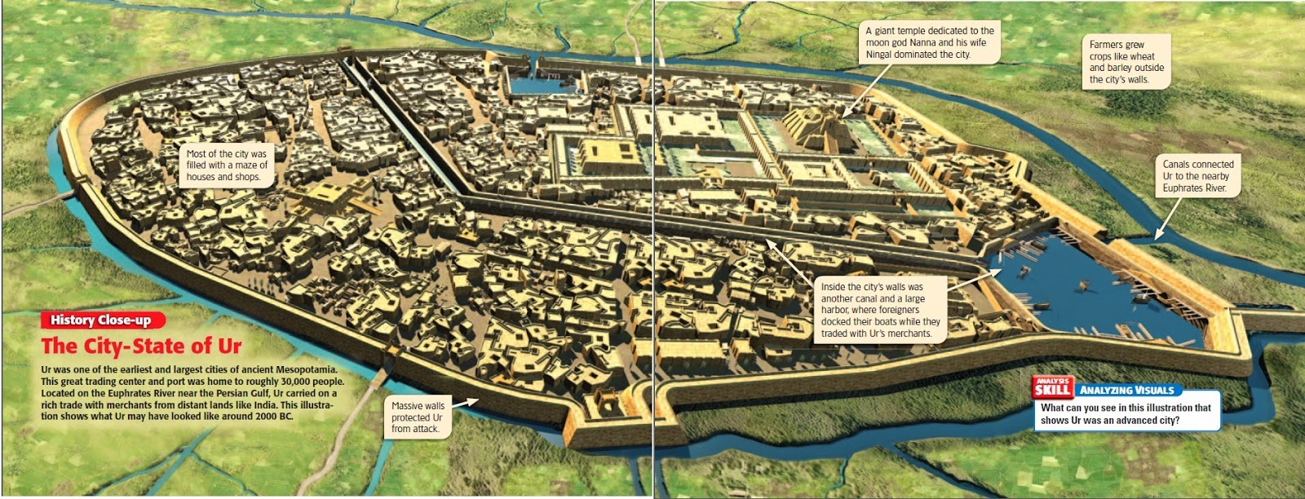
City State
A city and its surrounding area/land it controls.

Slide 12
Empire
Nation or group of City - States ruled by one emperor.
Emperor
Ruler of an empire

Slide 13
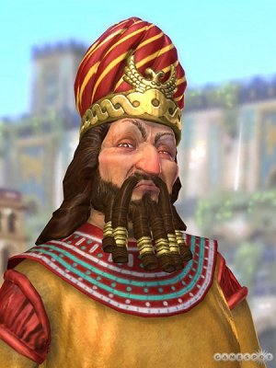
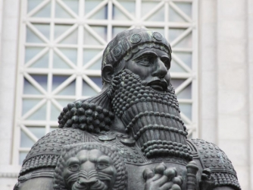
Hammurabi
1st Emperor with a Code of Laws

Slide 14
CODE OF HAMMURABI
Oldest set of laws ever recorded. 282 laws meant to keep order in ancient Babylon

Slide 15
CLASS SYSTEM
System in which a society is divided into several social groups (by wealth)

Slide 16
CUNEIFORM
Oldest form of writing
wedge shaped symbols on clay tablets

Slide 17
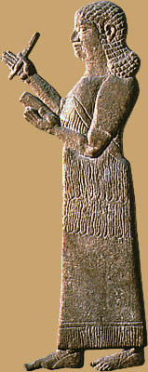
Scribe
Professional writer

Slide 18
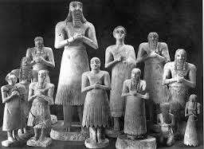
Polytheism
Belief in many gods

Slide 19
ZIGGURAT
A pyramid shaped tower with a temple on top…used for Religious purposes in Mesopotamia

Slide 20
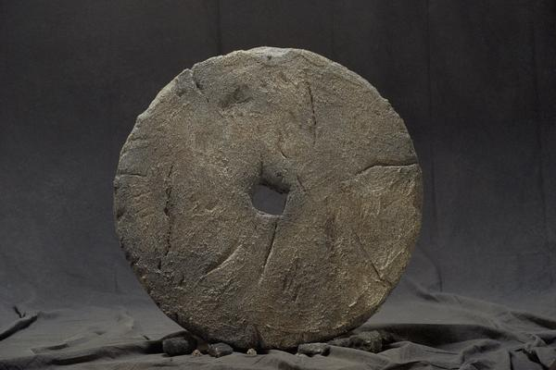
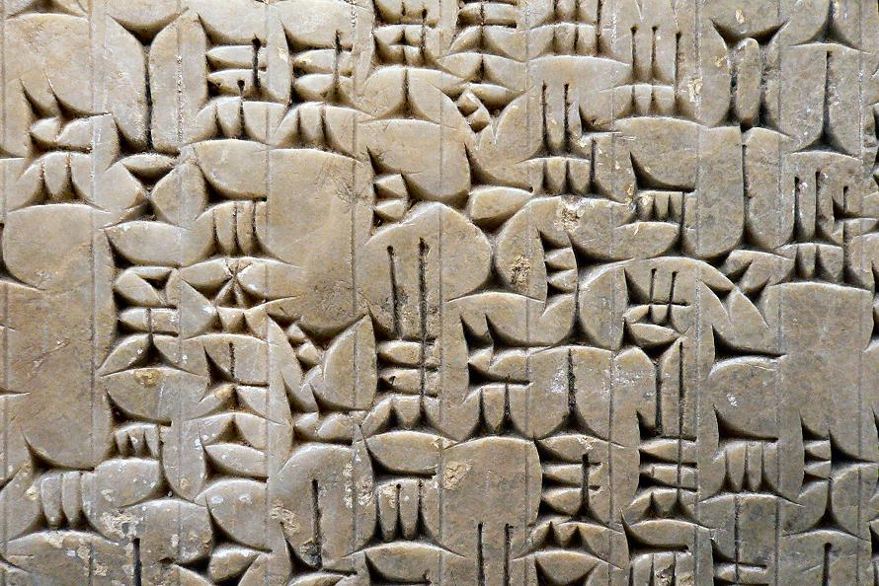
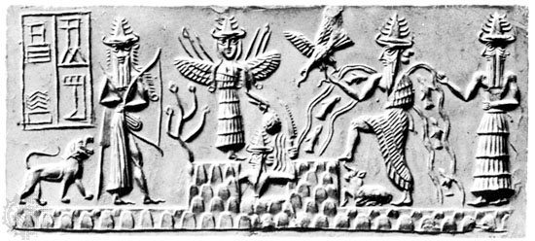
CONTRIBUTIONS
Something the Sumerians did or made and passed on to future societies.
Examples
wheel
Cuneiform (writing)
religion

Slide 21
SPECIALIZATION
Focusing on one specific skill or job.
Your specialty

Slide 22
SURPLUS
An amount that has been LEFT OVER after a need has been met.
(ex. Food surplus)

Slide 23
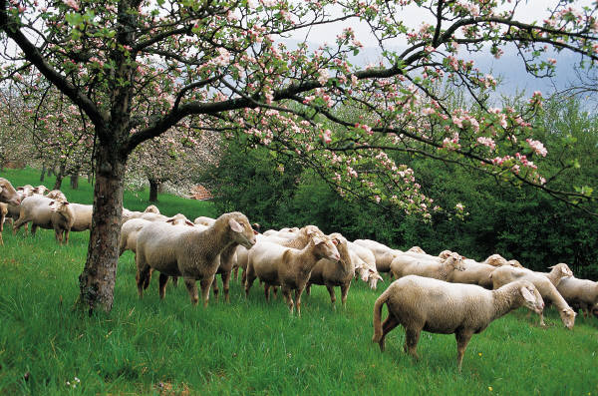
DOMESTICATION
To tame; Raising animals for food

